Slide 1
Analysis of Bank Analytics Dashboard
Presented by:-
Ajay
Shobha
Sravanthi
ronak

Slide 2
Table of Contents
Introduction
Objectives
Tools & Methodology
Limitations
Summary
Conclusion

Slide 3
Introduction
Banks rely on loans as their primary source of income (through interest).
Effective loan monitoring ensures profitability and risk control.
The Loan Dashboard provides a visual overview of lending performance.
Covers disbursement, collections, defaults, risk, and customer segments.

Slide 4
Objectives
To analyze total loan disbursement and collections.
To evaluate branch-wise, state-wise, and product-wise loan performance.
To identify defaulted and delinquent loans for risk management.
To understand borrower demographics (age, religion, credit grade).
To track loan trends over time and forecast growth.
To provide stakeholders with actionable insights for decision-making

Slide 5
Tools Used
Excel → Data cleaning & initial dashboard creation.
SQL → Loading loan datasets into a structured database.
Power BI / Tableau → Data modeling, visualization, interactive dashboards.
Visualization Features Used:
Slicers (branch, state, product type).
Drill-down charts (branch → loan → customer).
KPIs with card visuals (Total Loan Amount, Default Rate).

Slide 6
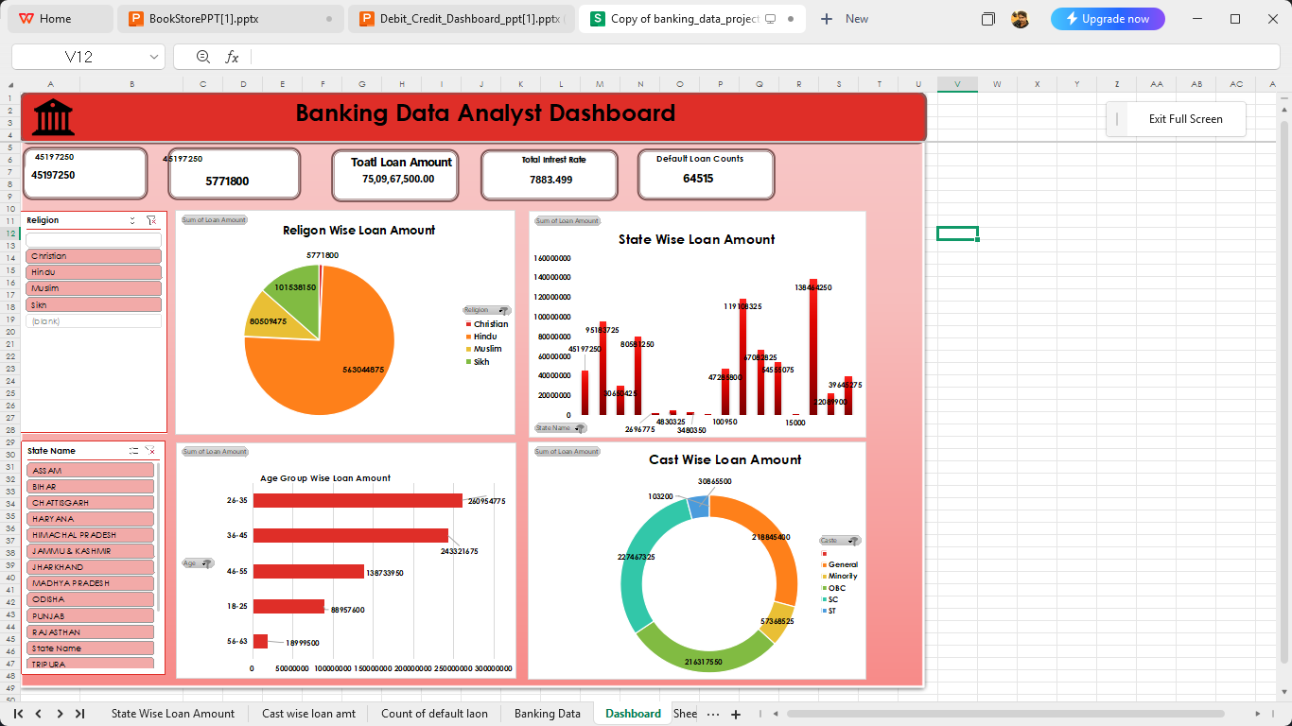
EXCEL DASHBOARD

Slide 7
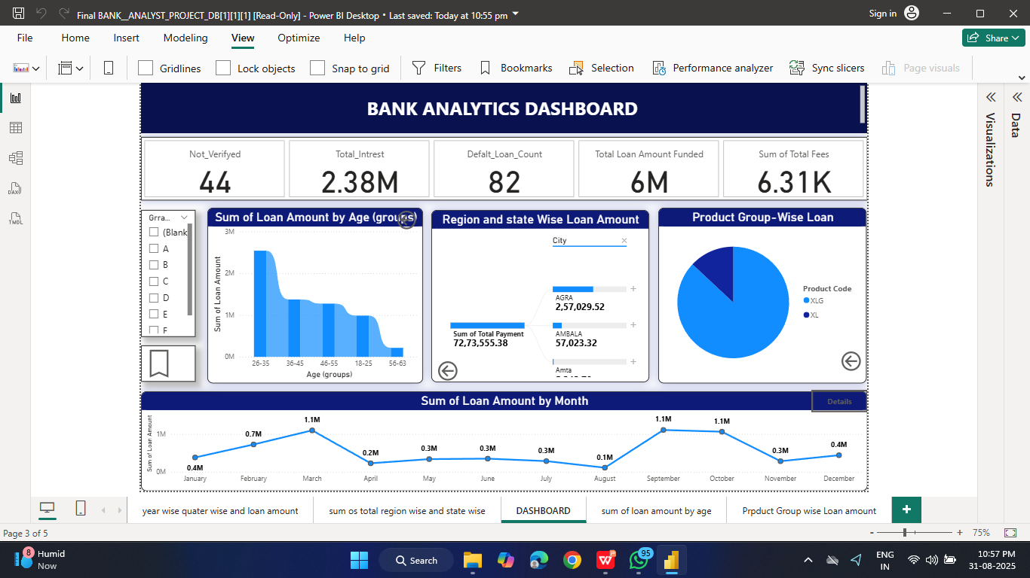
POWERBI DASHBOARD

Slide 8
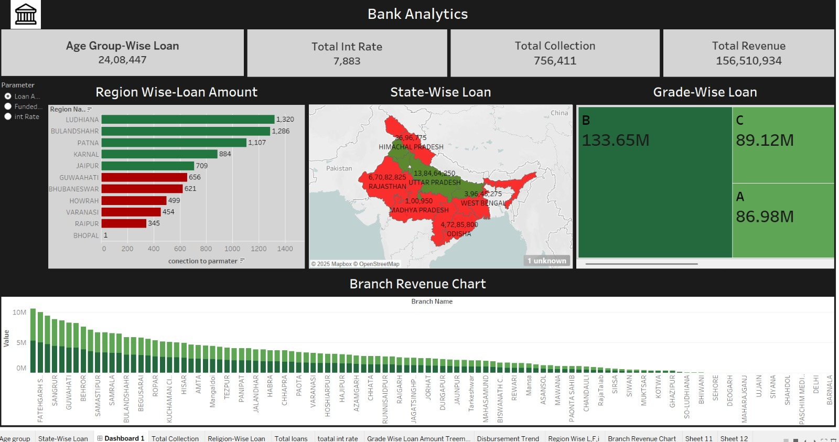
TABLEAU DASHBOARD

Slide 9
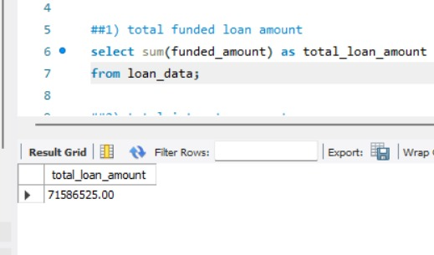
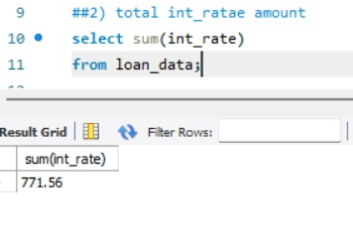
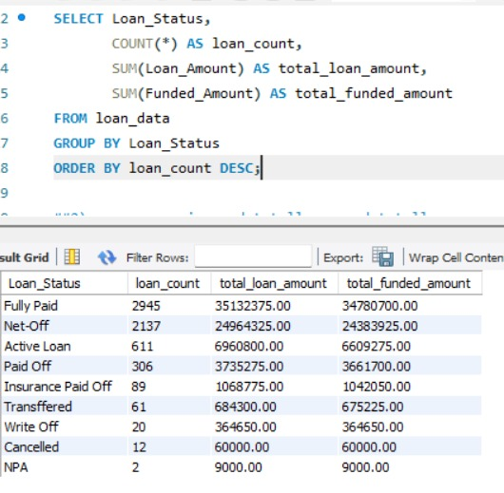
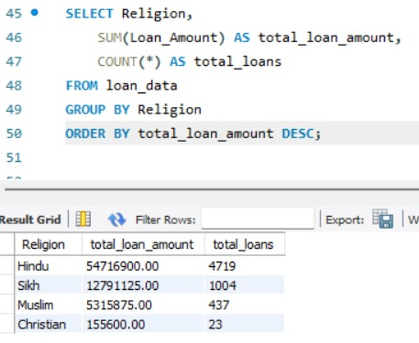
SQL SNAPSHOTS

Slide 10
LIMITATIONS
Data Dependency: Accuracy depends on quality of loan records.
Data Privacy: Customer-sensitive data must be secured.
Time Lag: Dashboard may not reflect real-time data.
Scope Limitations: Focuses on loans only (not overall banking).
External Factors: Doesn’t include macroeconomic risks (interest rate hikes, inflation).

Slide 11
KEY FINDINGS
High Loan Disbursement in certain states/branches → growth hubs.
Default Loan Rate higher in specific branches → requires stricter screening.
Delinquent Clients concentrated in younger age groups → repayment issues.
Product Group Insights: Personal loans have higher defaults; auto/home loans more stable.
Revenue Insights: Interest income is a major revenue driver; fees contribute less.
Verification Gaps: Significant loans without verification → compliance risk

Slide 12
SUMMARY
Loan Dashboard provides a holistic view of loan portfolio health.
KPIs (Total Loans, Collection, Interest) → measure profitability.
Risk Metrics (Default/Delinquency Rates) → highlight problem areas.
Demographic Segmentation → helps design targeted loan products.
Geographic/Branch Analysis → guides resource allocation

Slide 13
Conclusion
The dashboard helps banks balance growth and risk.
Identifies profitable products & branches while flagging risk zones.
Enables data-driven decision-making for loan strategy.

Slide 14
Debit and Credit Dashboard Analysis

Slide 15
INDEX
Introduction
Objectives
Tools used for Data analysis and their limitations
Dashboard
Findings
Summary
Conclusion

Slide 16
INTRODUCTION
This analysis provides insights into debit and credit transactions across banks and branches.
It evaluates transaction methods, balances, customer activity, and key ratios to help understand overall financial performance.

Slide 17
Objectives
To analyze debit and credit transactions across different banks and branches.
To evaluate transaction methods (Bank Transfer, Credit Card, Debit Card).
To track KPIs like Net Transaction Amount, Credit to Debit Ratio, and Activity Ratios.
To identify top customers and bank performance trends.

Slide 18
Tools used for Data Analysis and Limitations
1. Excel
Limitations of excel:- Limited charting options for visual designing
2. Tableau Public
Limitations of Tableau Public :- Only allows access to the local data sources, being able to publish publicly only, and no data automation 3. Power BI
Limitations of Power Bi:- Slow performance with large data sets

Slide 19
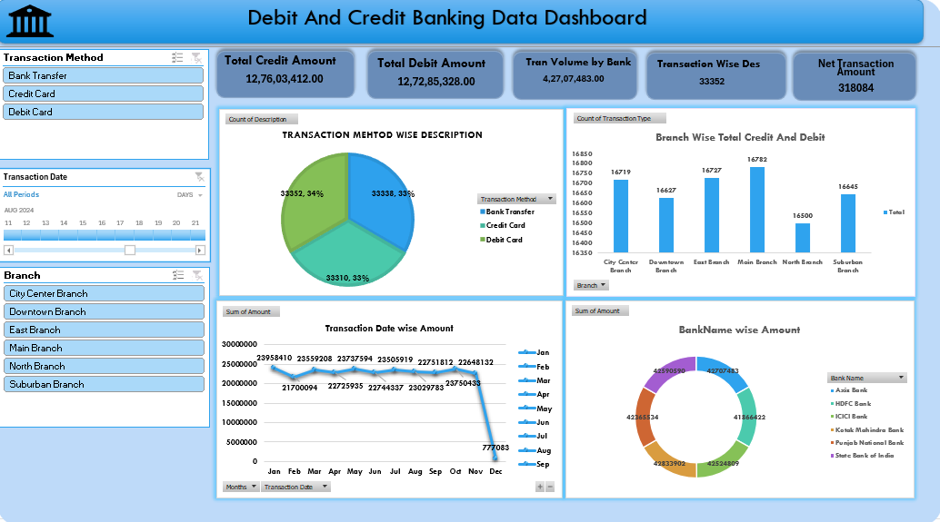
Excel Dashboard

Slide 20
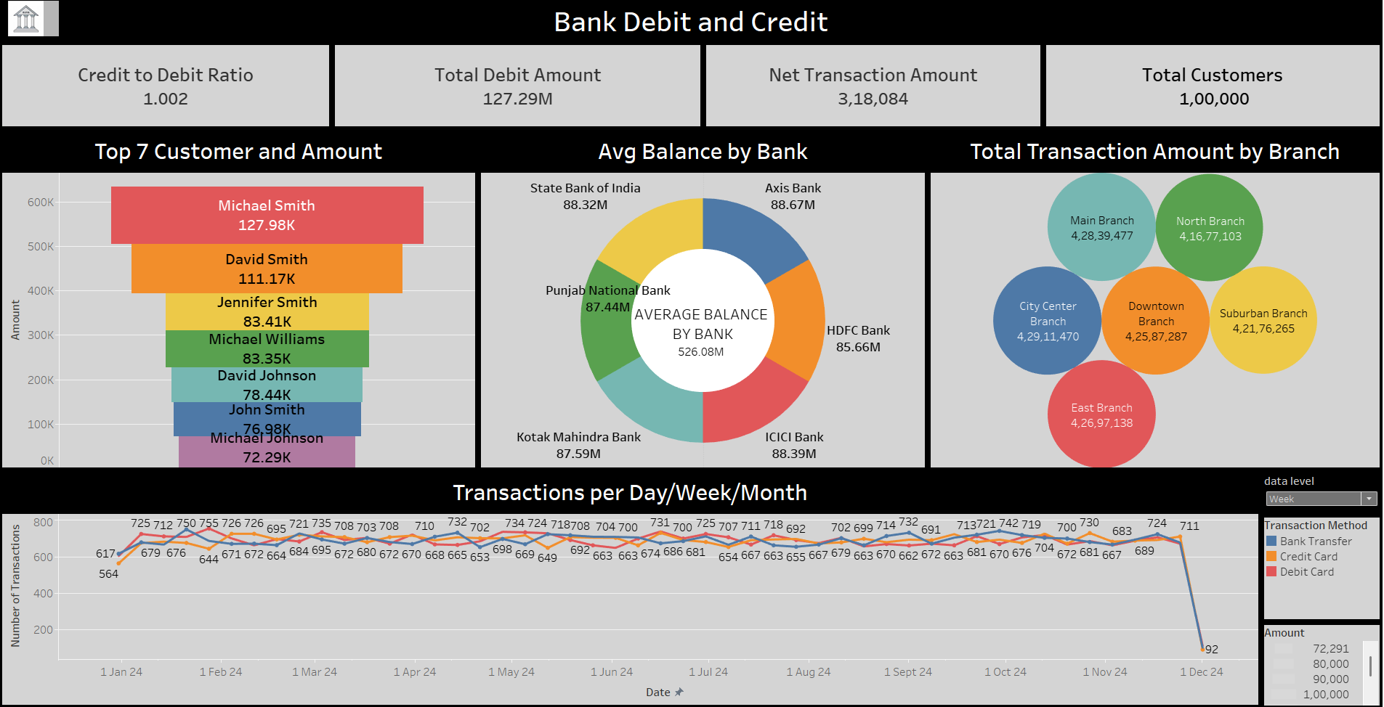
Tableau Dashboard

Slide 21
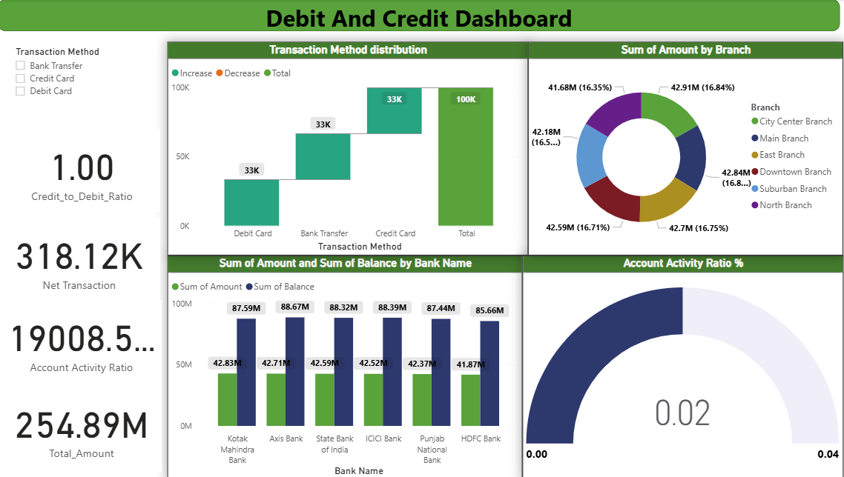
PowerBi Dashboard

Slide 22
Findings
Credit to Debit Ratio is stable across transactions.
Net Transaction Amount highlights significant activity.
Branch and Bank-wise distribution identifies high contributors.
Customer-level analysis shows key clients driving transaction volumes.
Transaction trends reveal seasonal and method-based variations.

Slide 23
Conclusion
The analysis highlights key trends in debit and credit transactions.
KPIs support monitoring of financial health and performance.
Insights assist in improving transaction efficiency and customer engagement.
Findings can guide strategic planning for banks and branches.

Slide 24

Thank you

